Slide 1
Vaginal Discharge
Dr. Smrity Maskey Pradhan
Associate Professor
KIST Medical College and Teaching Hospital.
Edited

Slide 2
Objective
By the end of this class student will be able to:
Define vaginal discharge
Explain sign and symptoms of infection
Classify types of vaginal discharge and infection
Manage vaginal discharge( history, investigation amd treatment)

Slide 3
Defination:
Normal vaginal discharge : Secretion from upper and lower genital tract.
Leucorrhoea : Normal excessive amount of vaginal discharge .

Slide 4
Causes :
Physiological causes :
New born girl
Onset of puberty
Premenstrually
Time of ovulation
Sexual excitement
Pregnancy
Contraception ( IUCD, OCP)
Posture at work

Slide 5
Causes :
Benign conditions :
Cervical erosion
Pelvic congestion
UVP
Infective discharge :
Vulvovaginitis : Trichomonal, Candidial, BV, Gonoccocal, Pyogenic.
Cervicitis : Gonoccocal, puperal infective, cervical erosion
Endometritis : puerperal or senile.

Slide 6
Causes :
Growth related discharge:
Benign : cervical polyp, submucous fibroid
Malignant : cancer of any part of genital tract.
Miscellaneous causes :
FB
VVF
RVF
Hydrosalpinx / ascitic fluid draining through FT, Utreus and vagina.

Slide 7
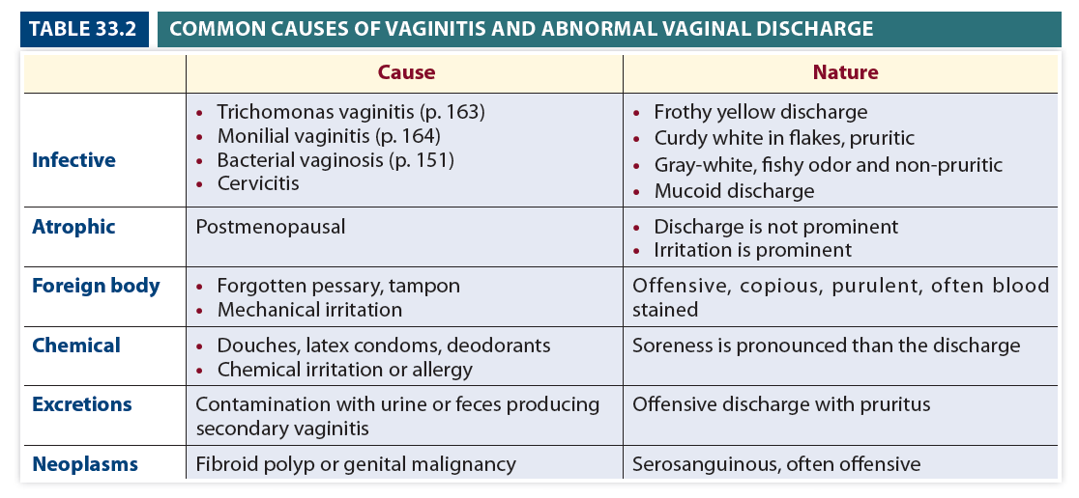

Slide 8
Management
History
Age ( young, reproductive, old)
Onset ( sudden, gradual)
Colour (white with brown stain, blood mixed)
Smell ( odour less, offensive)
Pruritus ( infection)
UVP history
PID history
Contraception history
Relation with menstruation, ovulation, pregnancy
Occupation

Slide 9

Management :
Examination:
Inspection : Vulva may show excoration and redness.

Slide 10
Management
Examination | Physiological | Infective | Growth
Speculum | -Generally normal -IUCD thread seen -Cervical erosion seen | -Trichomonas: yellow, froathy discharge, strawberry cervix. -Candida : curdy white discharge. -BV :milky white discharge | Growth can be seen.

Slide 11


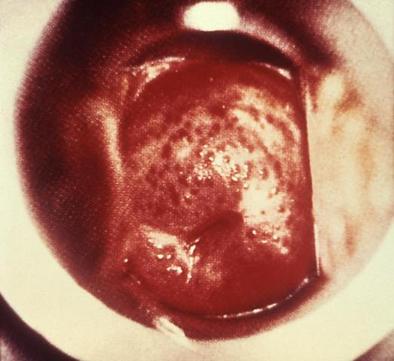
Trichomonas

Slide 12
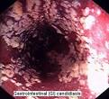

Candida Infection

Slide 13

Bacterial Vaginosis

Slide 14
Management
Investigation
Investigation | Physiological | Infection | Growth
Wet smear | Epithetial cell + | Pus cell +, candidal spores+, clue cell+ | No sp. Feature, blood cell +
KOH test | -- | Fishy smell +
Gram stain | Lactobacilli | Candida spore, clue cell, intracelluar diplococci
pH | Normal | >4.5 in BV, >0.5 in trichomoniasis
Pap smear | Normal | Inflammatory | Malignant cells +
Culture |  | Specific organism growth +

Slide 15
Management
Treatment | Physiological | Infection | Growth
 | Reassurance, hygine, ? Cx Cautry | Antimicrbial agents | Surgery, chemotherapy, radiotherapy

Slide 16
Antimicrobials:
Candida : Fluconazole, Ketoconazole
Trichomoniasis : Metronidazole, Tetracycline, Clotrimozole, Tinidazole in both patners.
BV : Metronidazole, Clindamycin
Chlamydial infection : Tetracycline, Erythromycin
Gonorrhoea : Penicillin

Slide 17
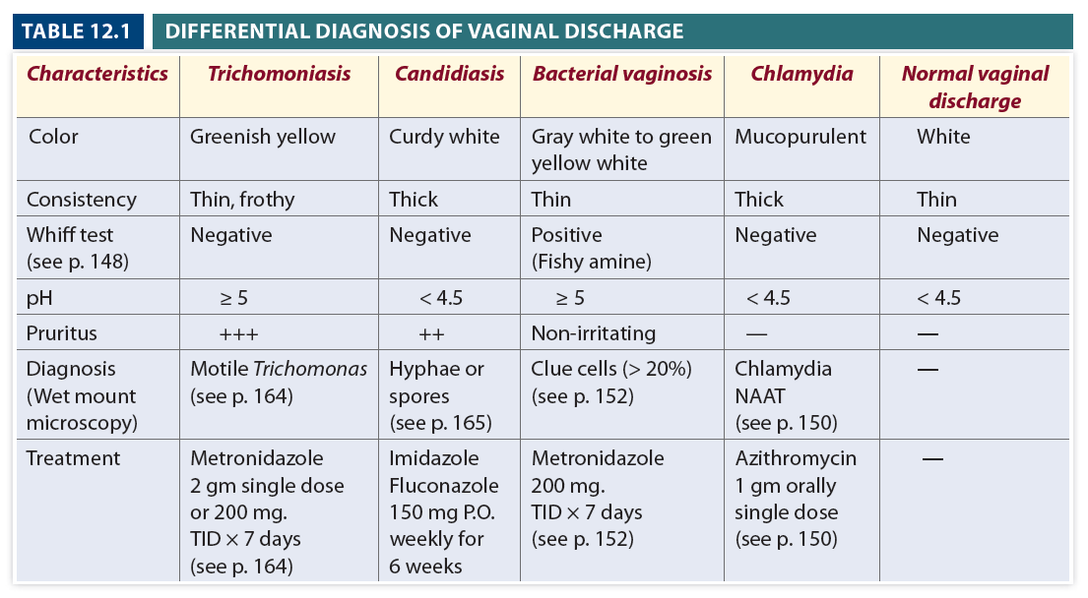

Slide 18
Thank you

